Slide 1
JobCorner
HOW TO CREATE A GOOD WORK ATMOSPHERE
Project Presentation – Rakha Naufal Akbar Fikri

Slide 2
TABLE OF CONTENTS
01
ABOUT
02
TECH STACK
03
APP FEATURES
04
DEMO APP
HOW TO CREATE A GOOD WORK ATMOSPHERE
Everything about the app
Technologies used to build the app
Main Features of the App
Live Demo of the App

Slide 3
JobCorner
HOW TO CREATE A GOOD WORK ATMOSPHERE
A web-based app to search for jobs, mainly IT-related jobs, worldwide. It has many features to make your job-seeking process easier to do!

Slide 4
ABOUT THE APP
WHAT
WHO
WHY
WHEN
WHERE
HOW
An app to search for tech-related jobs worldwide
Jobseekers who are lookiing for tech related jobs
Makes your jobseeking process easier
June 22 – 24, 2022
Worldwide ☺
Will be explained in the next slide

Slide 5
02
TECH STACK
HOW TO CREATE A GOOD WORK ATMOSPHERE

Slide 6



TECH STACK - FRONTEND
React.js
Semantic UI React
Sweetalert 2
Frontend JS Framework for building UI Components
Make building UI Components faster and easier
Handling Alerts and Popups

Slide 7




TECH STACK - BACKEND
Node.js
Express.js
PostgreSQL + Sequelize
Building the server-side environment of the app
Node.js framework to build APIs of the app
Building the database environment

Slide 8



TECH STACK - OTHERS
Axios
JWT
Redux
Make API Requests
Authenticate registered users
Handling app states

Slide 9
03
APP FEATURES
HOW TO CREATE A GOOD WORK ATMOSPHERE

Slide 10
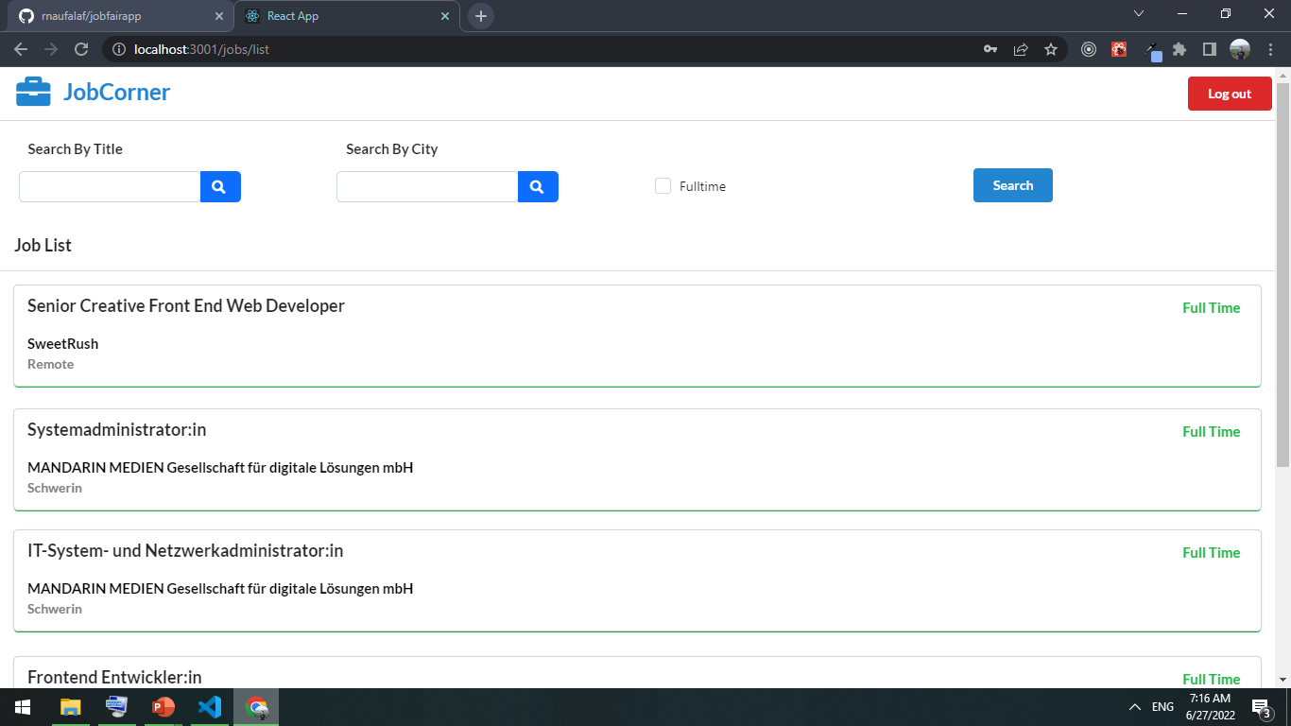
APP FEATURES - HOMEPAGE

Slide 11
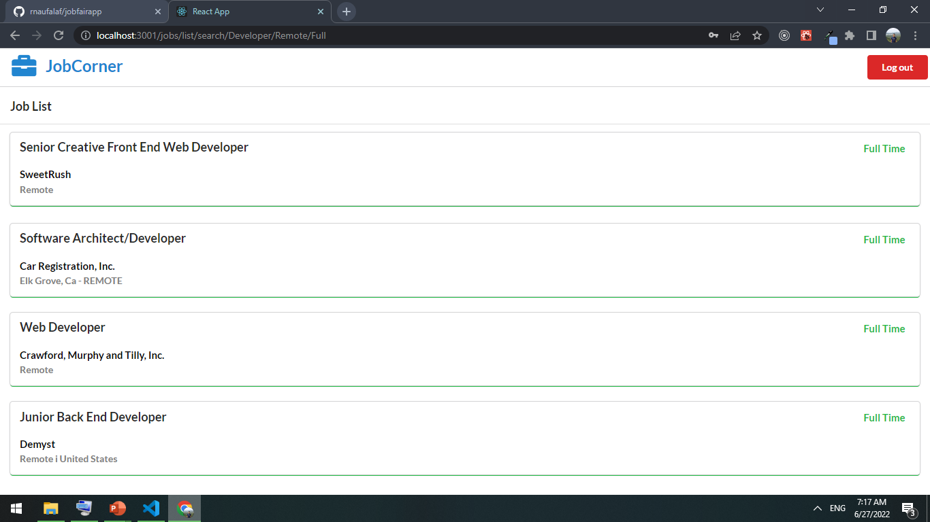
APP FEATURES – SEARCH & FILTER

Slide 12
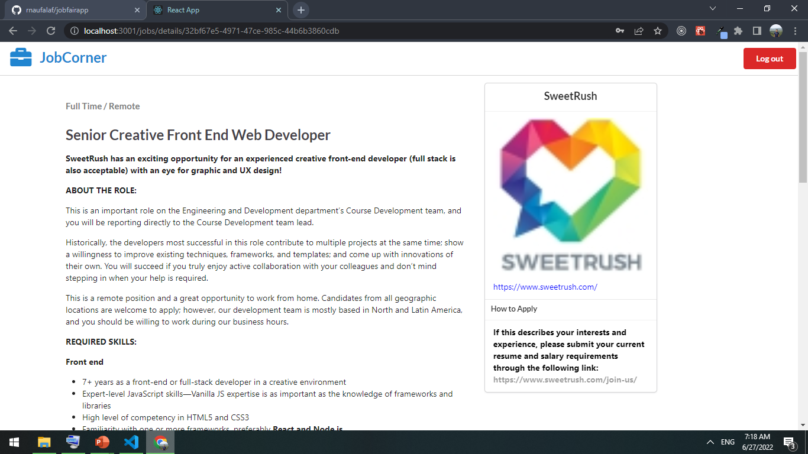
APP FEATURES – JOB DETAILS

Slide 13
04
DEMO APP

Slide 14
THANKS!
Rakha Naufal Akbar Fikri
rnaufalaf@gmail.com
+62 81 235496545
Check the repo at :
github.com/rnaufalaf/react-jobfair
Please keep this slide for attribution

